Slide 1
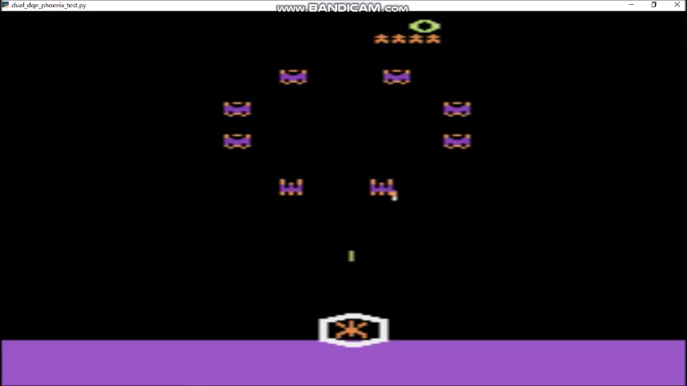
Reinforcement Learning for Phenix Game
Source: Roy Zhang’s Master’s Project @ ODU

Slide 2
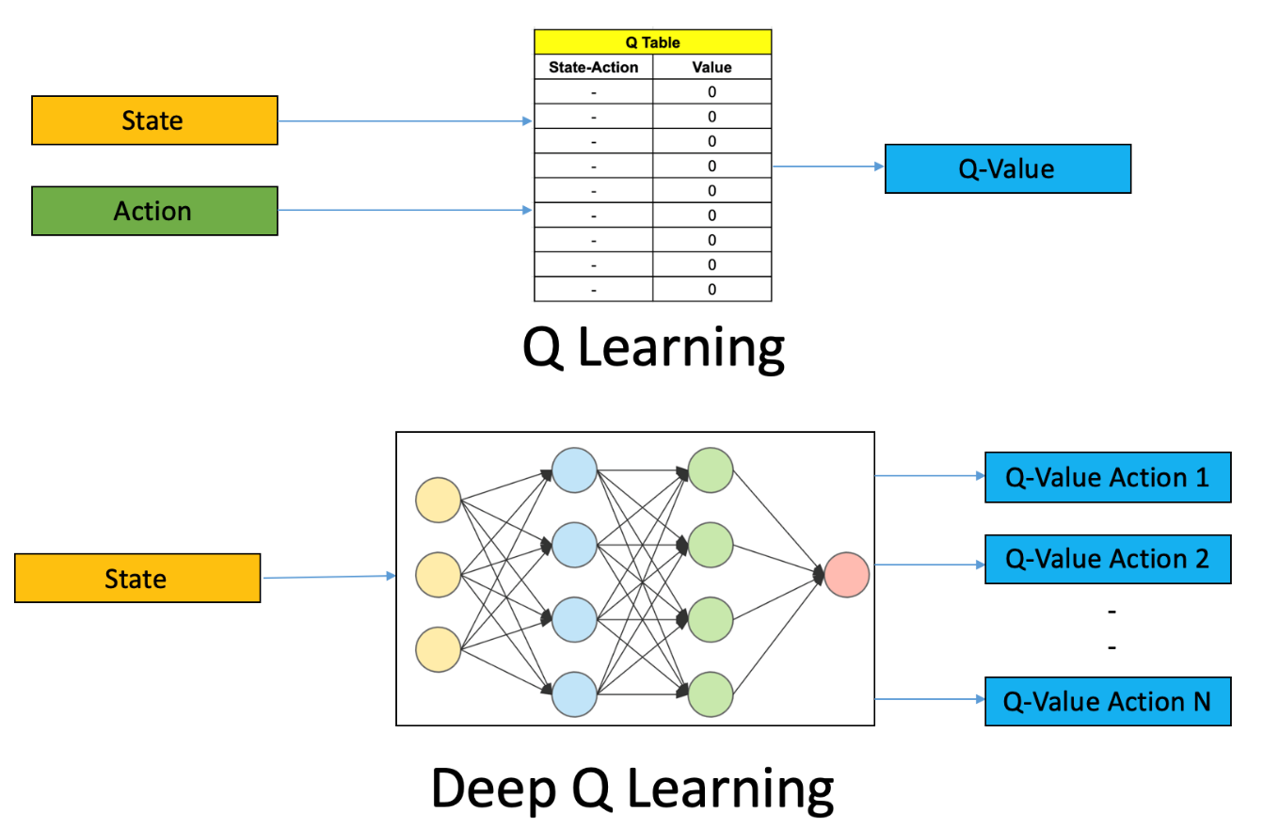
Deep Q-Learning
Deep Q-Learning is a model-free approach to reinforcement learning using deep neural networks in environments with discrete action choices

Slide 3
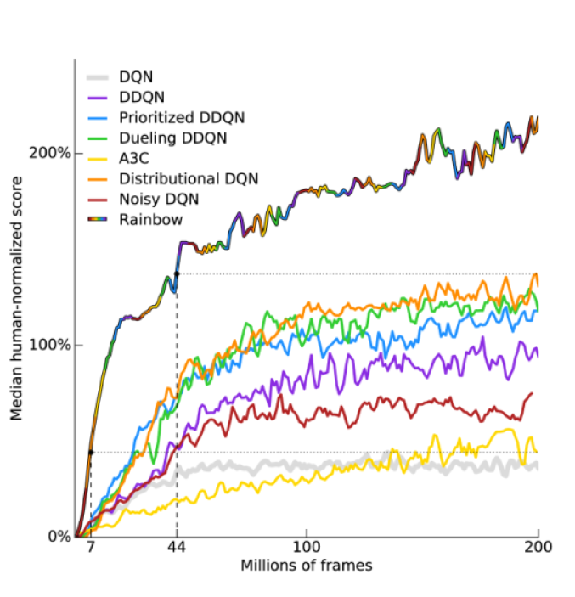
Deep Q Learning in Game Playing
Rainbow combination of 6 extensions of DQN and achieves best performance
Takes 18 million frames (83 hours) to match human performance
Median Performance on 57 Atari games relative to human performance

Slide 4
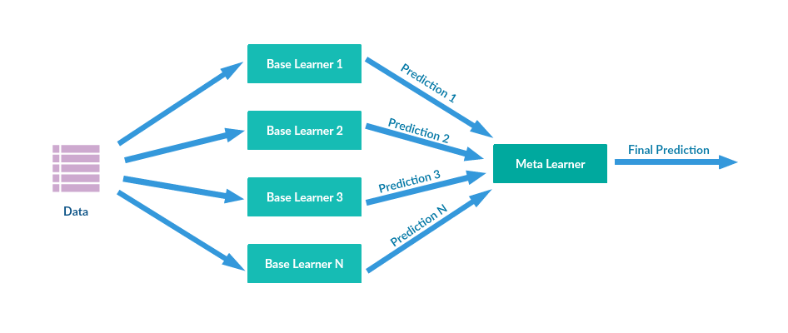
Ensemble-based Learning
Ensemble learning
Uses a set of models
Obtained by applying a learning process to a given problem.
Integrated in some way to obtain the final prediction.
Aggregation of a set of models
Reduce the likelihood of selecting a poor or biased model
Goal of improving accuracy

Slide 5
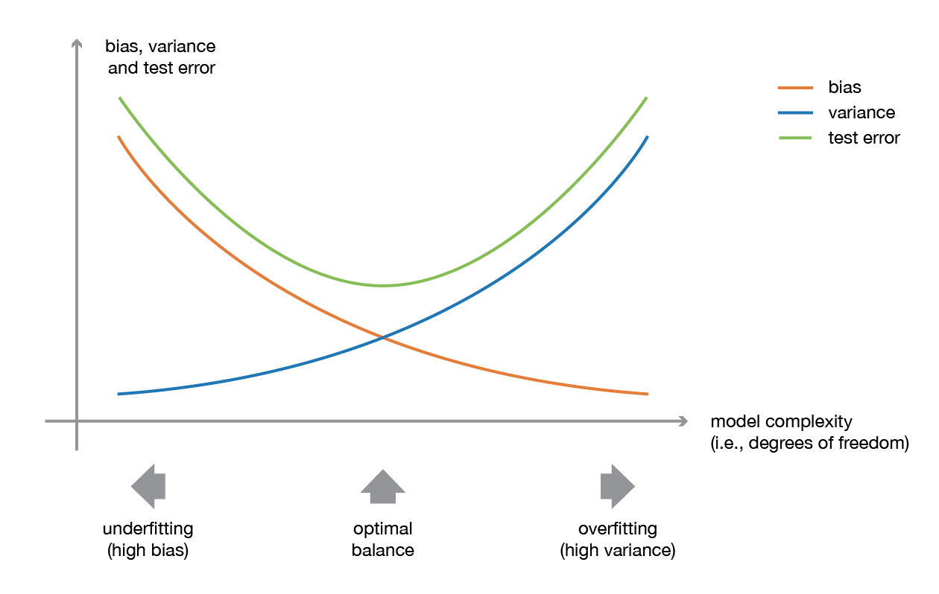
Advantages of Ensemble Learning
Bias-Variance Tradeoff
Model with low-complexity
Low variance, high bias
Model with high-complexity
High variance, low bias
Ensemble Learning
Rationale: Combine weak learners to build a strong learner
Reduce Variance
Reduce Bias

Slide 6
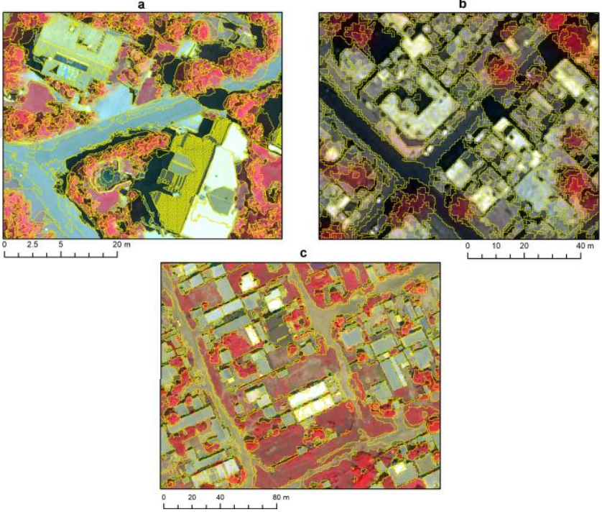
Very-High-Resolution Object-based Land Cover Classification
Combining weak learners to build a strong learner, XGBoost can achieve very high resolution object-based land cover classification based on remote sensing data.

Slide 7
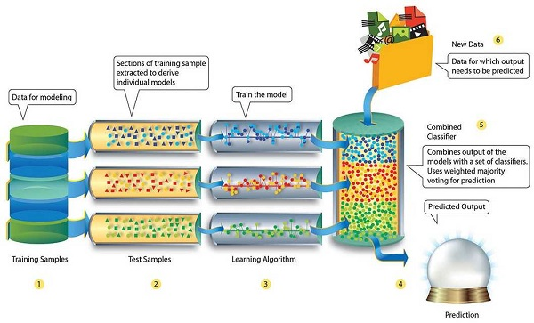
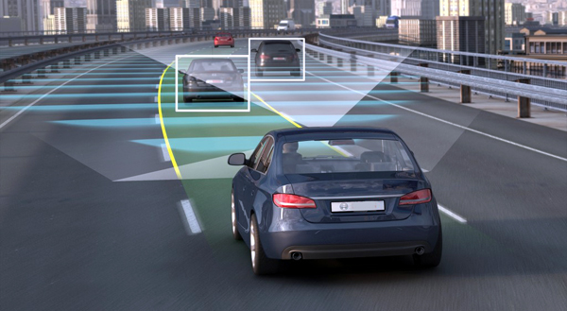
Ensemble Learning in Self-Driving Cars
Self-driving cars can make mistakes because of limited AI training situations. Ensemble learning can enhance reliability of AI models in self-driving cars.
https://mitechnews.com/autonomous-vehicles/report-self-driving-cars-makes-mistakes-because-of-limited-ai-training-situations/

Slide 8
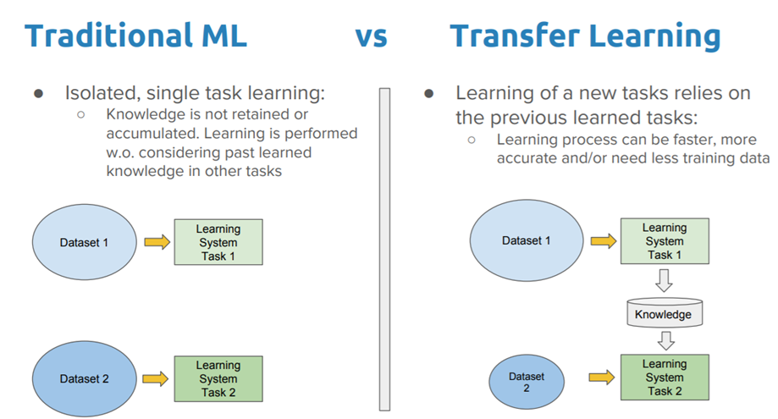
Transfer Learning
Transfer Learning
A model trained on one task is re-purposed on a second related task

Slide 9
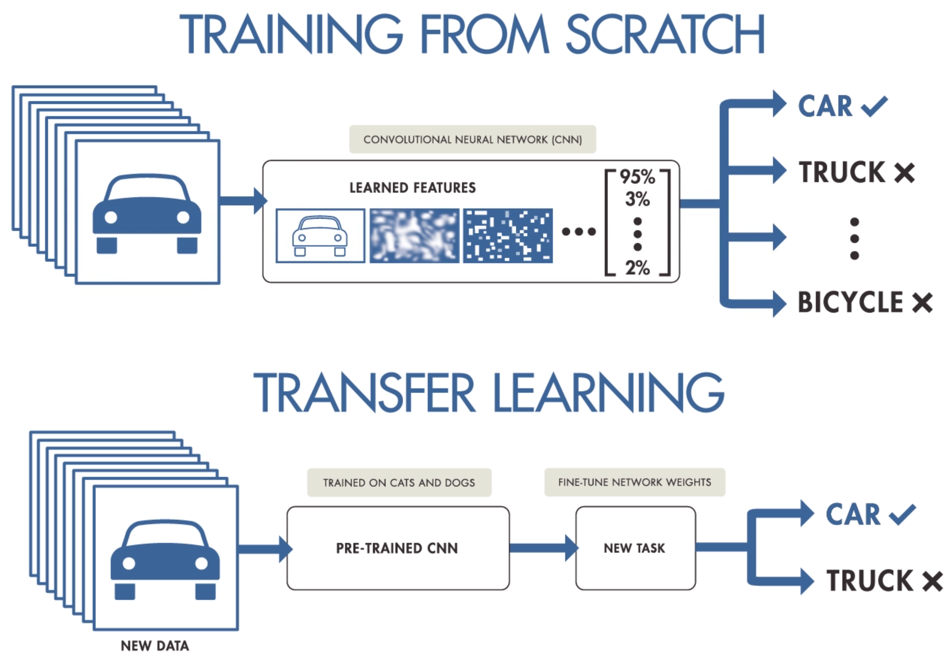
Transfer Learning

Slide 10
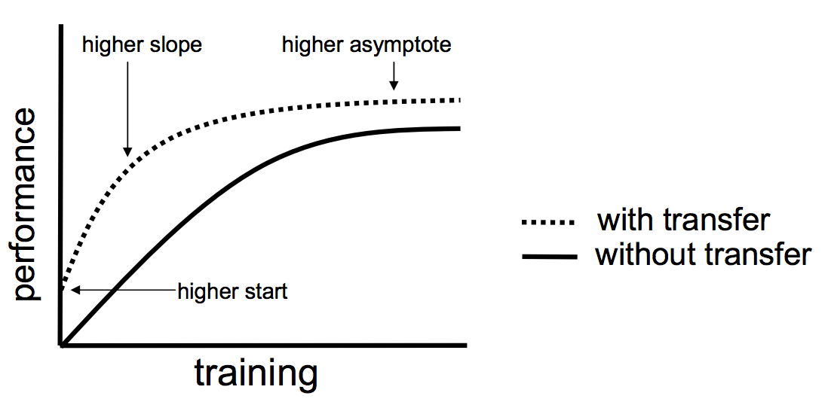
Benefits of Transfer Learning
Higher start
The initial skill on the source model is higher than it otherwise would be
Higher slope
The rate of improvement of skill during training of the source model is steeper than it otherwise would be
Higher asymptote
The converged skill of the trained model is better than it otherwise would be

Slide 11

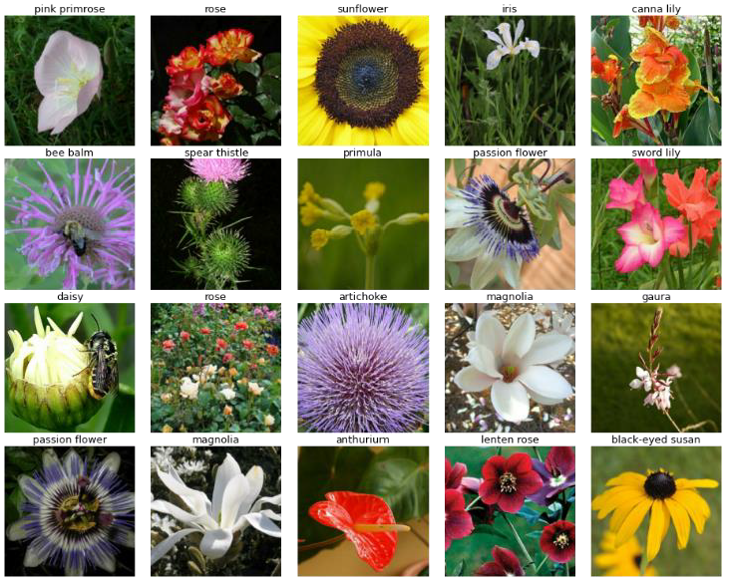
Transfer Learning Example (Flower Classification)
Transfer
ImageNet ResNet
Flower ResNet
 | Accuracy
ResNet trained from scratch | 72.1%
ResNet transferred from ImageNet ResNet | 99.2%

